Slide 1
NAT

Slide 2
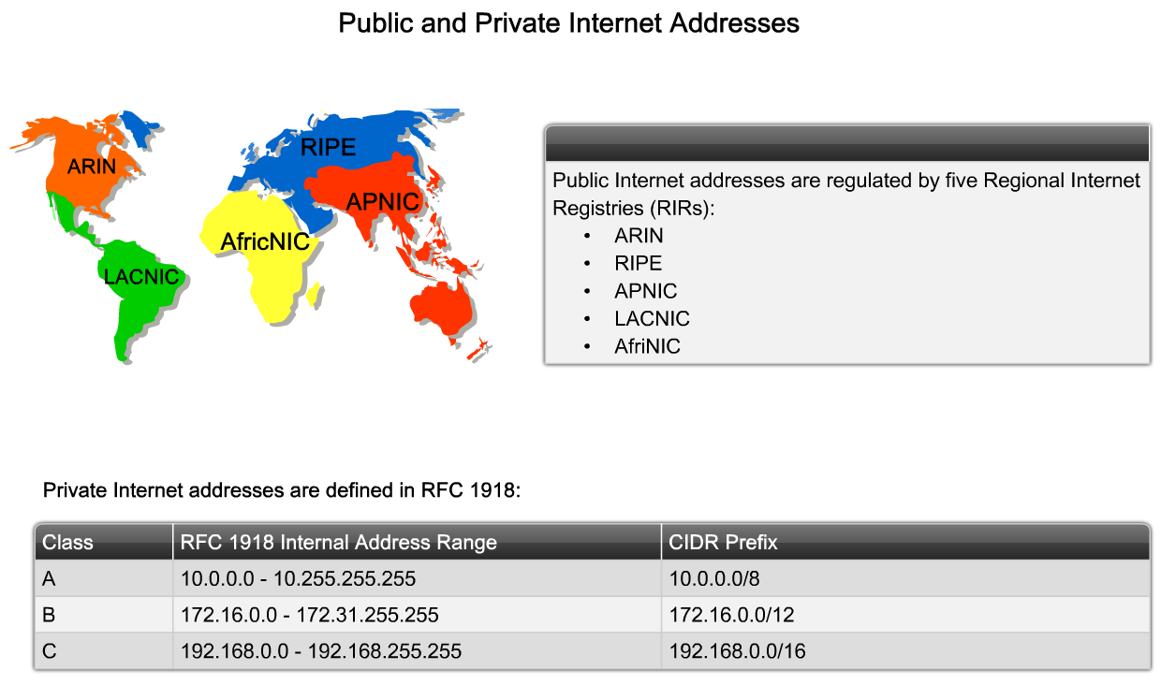
Network Address Translation
Notes:
Graphic 7.2.1.1

Slide 3
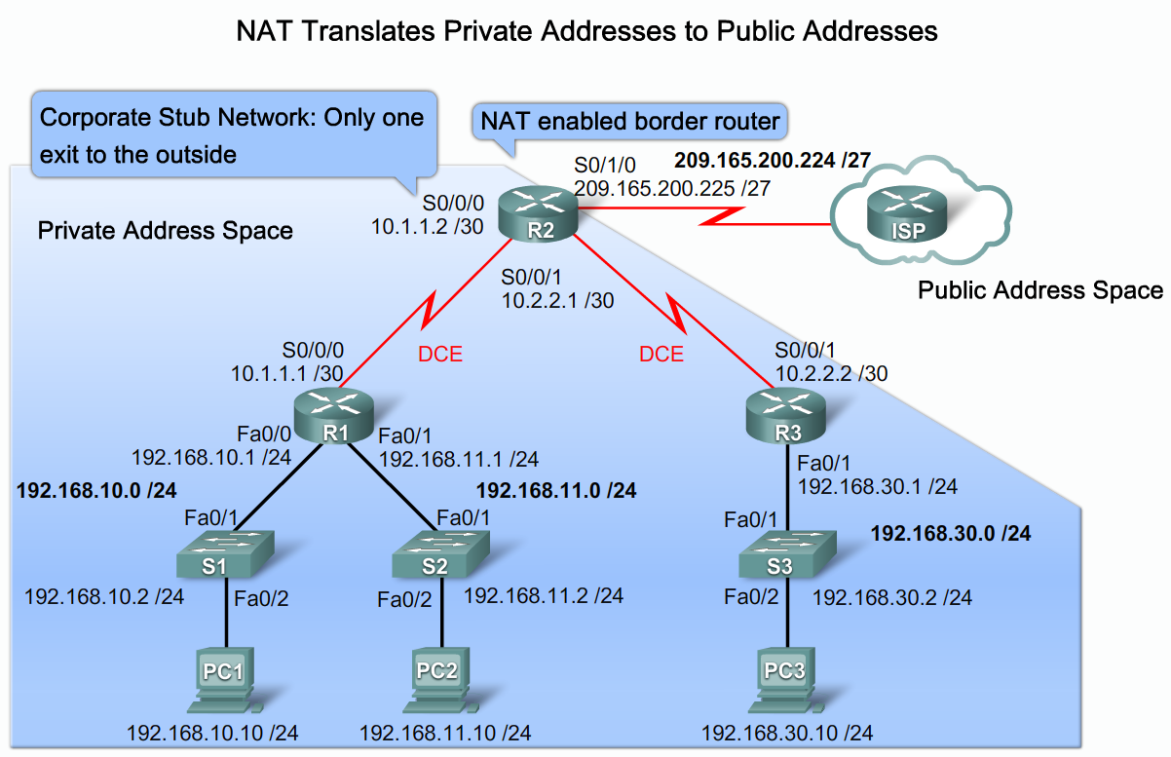
Network Address Translation

Slide 4
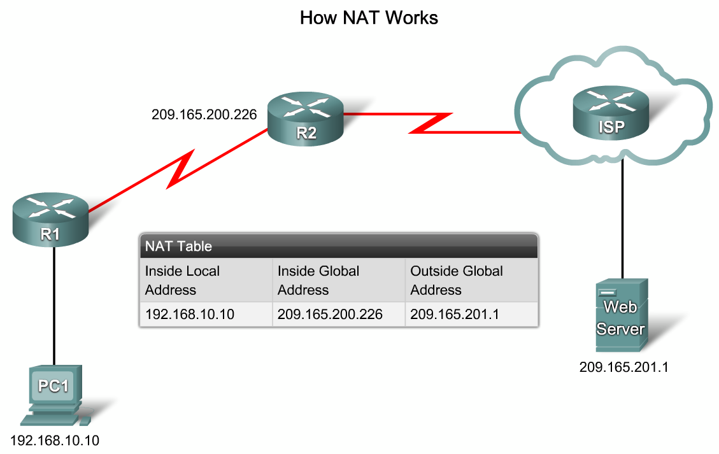
Network Address Translation

Slide 5
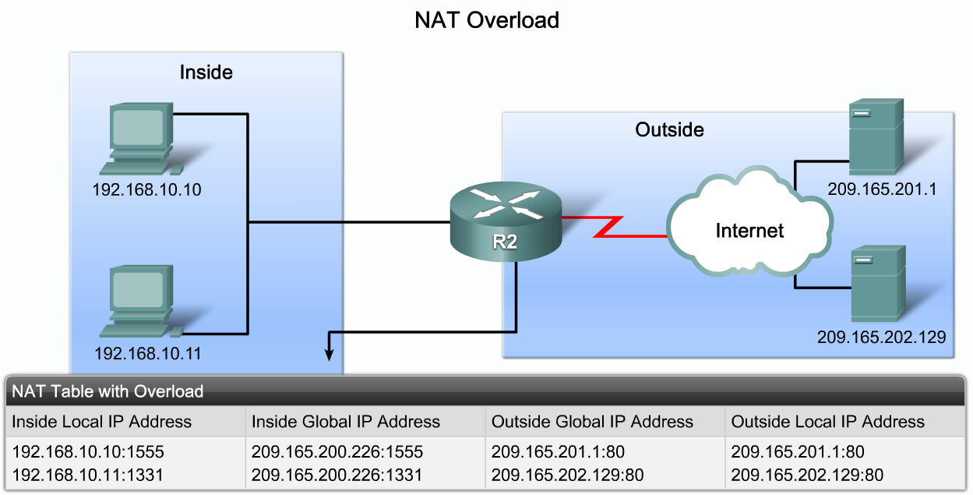
Network Address Translation

Slide 6
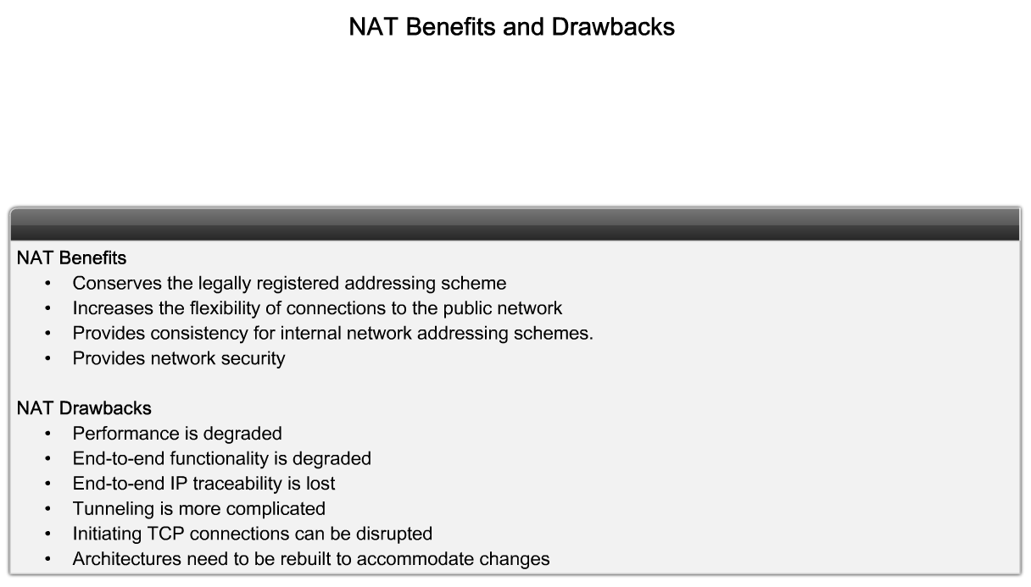
NAT benefits & drawbacks

Slide 7
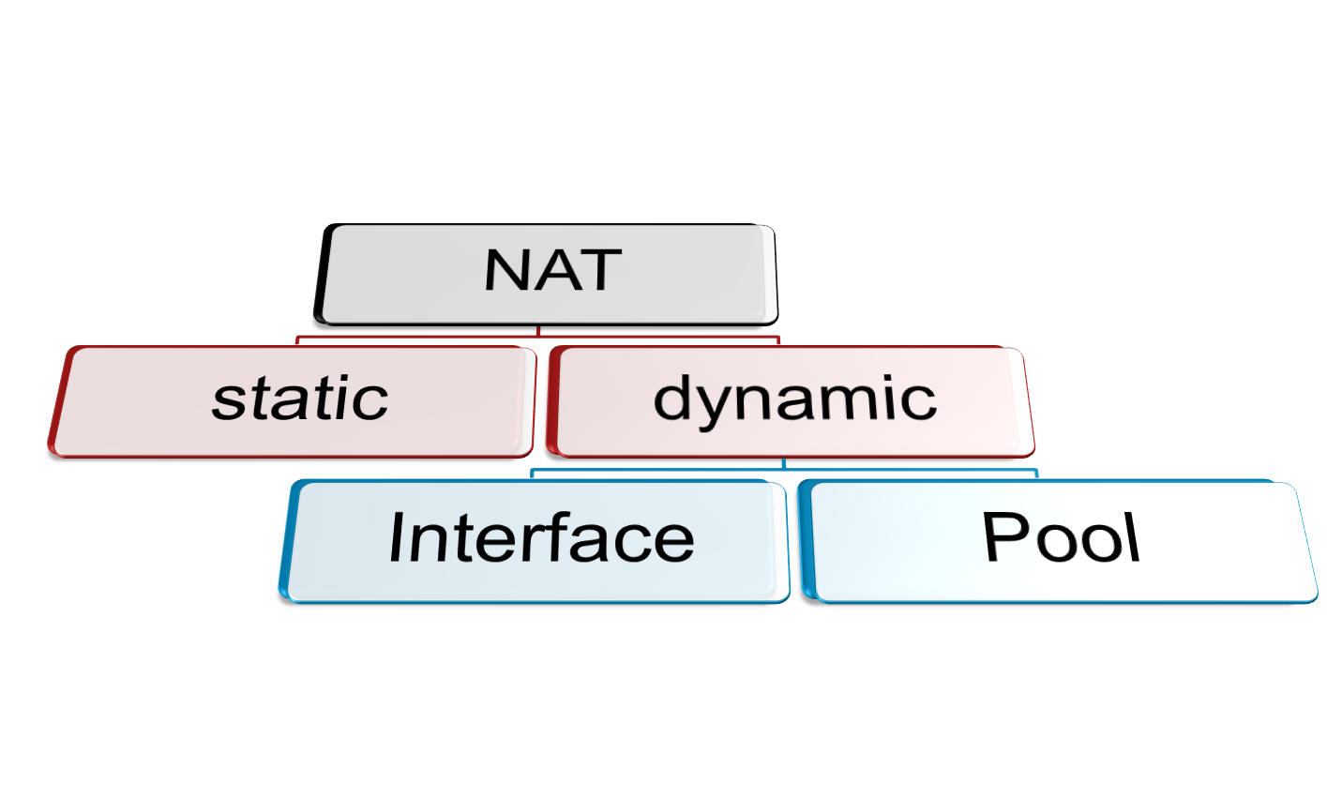
NAT configuration

Slide 8
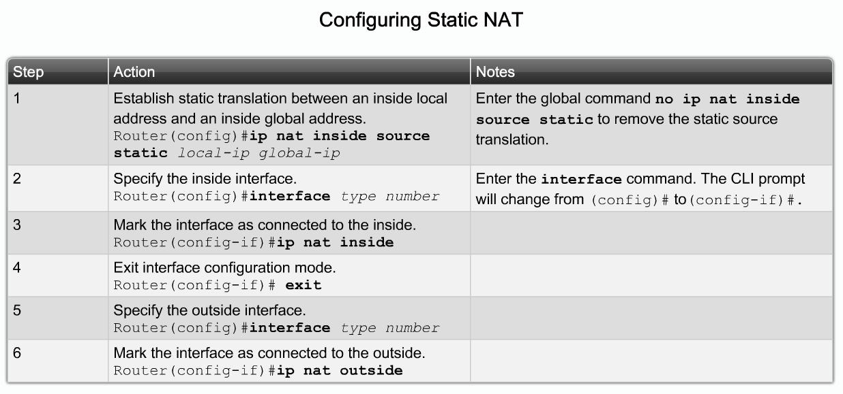
Static NAT

Slide 9
Static NAT
Static mapping
  Router(config)# ip nat inside source static inside-local inside-global
Apply NAT under interface
  At input interface → Router(config-if)#ip nat inside
  At output interface → Router(config-if)#ip nat outside

Slide 10
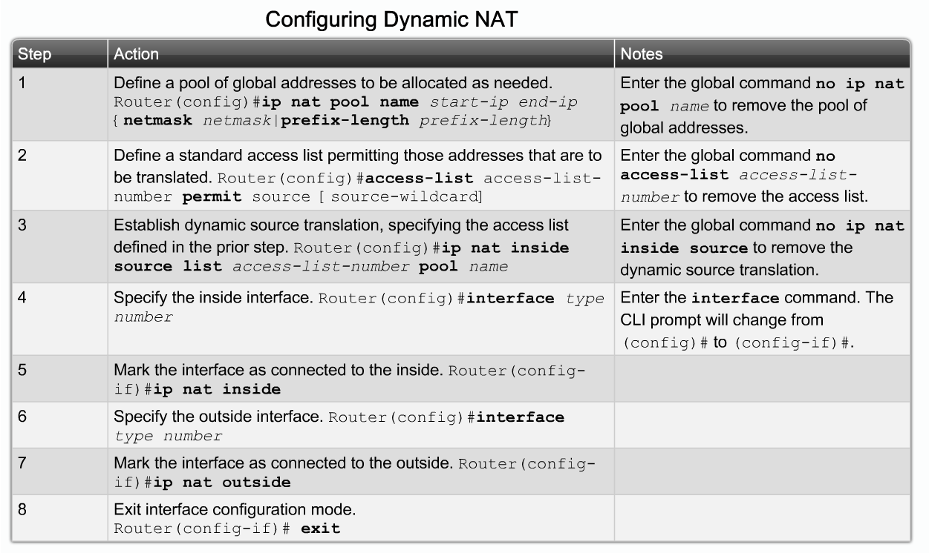
Dynamic NAT

Slide 11
Dynamic NAT pool
NAT pool
  Router(config)# ip nat pool NAME start-public-ip end-public-ip netmask subnet-mask
Access-list
  Router(config)# access-list (NO) …………………….
1+2
  Router(config)# ip nat inside source list (NO) pool NAME
Apply NAT under interface
  At input interface → Router(config-if)#ip nat inside
  At output interface → Router(config-if)#ip nat outside

Slide 12
Dynamic NAT with interface address
Specify the interface address used
Access-list
  Router(config)# access-list (NO) …………………….
1+2
  Router(config)# ip nat inside source list (NO) interface interface-type
Apply NAT under interface
  At input interface → Router(config-if)#ip nat inside
  At output interface → Router(config-if)#ip nat outside

Slide 13
Port forwarding
Port forwarding (sometimes referred to as tunneling) is the act of forwarding a network port from one network node to another. This technique can allow an external user to reach a port on a private IP address (inside a LAN) from the outside through a NAT-enabled router.

Slide 14
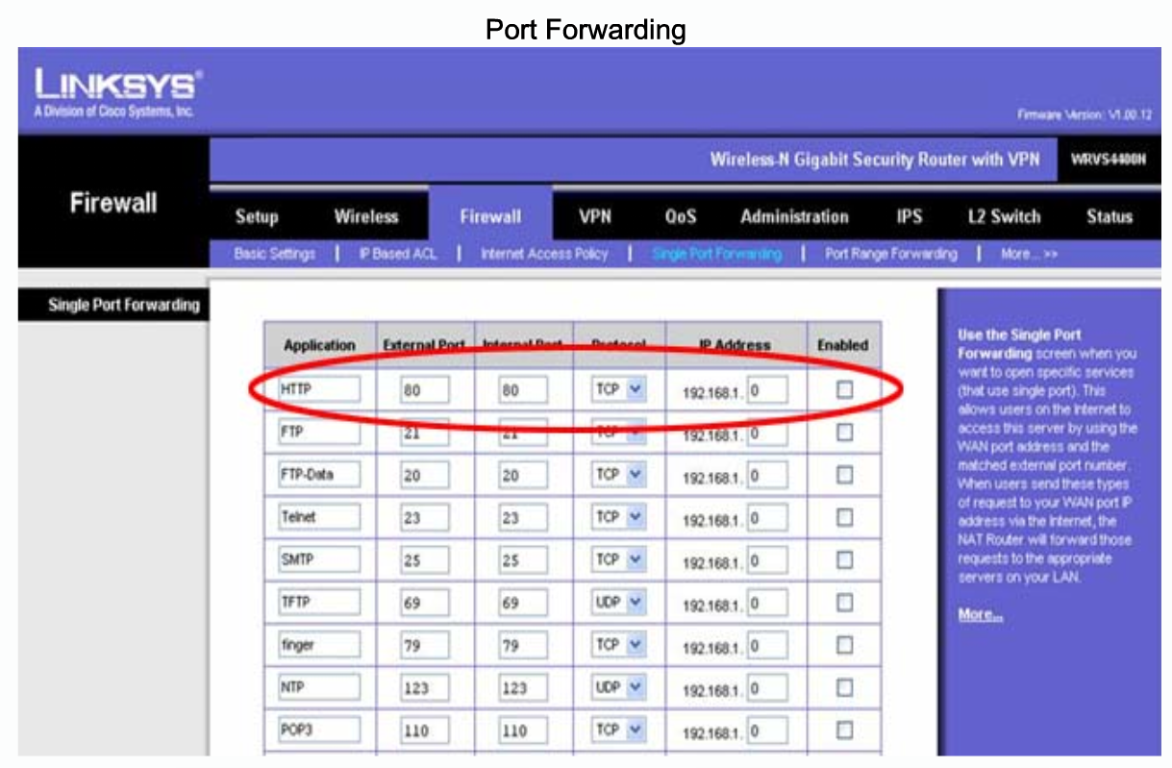
Port forwarding

Slide 15
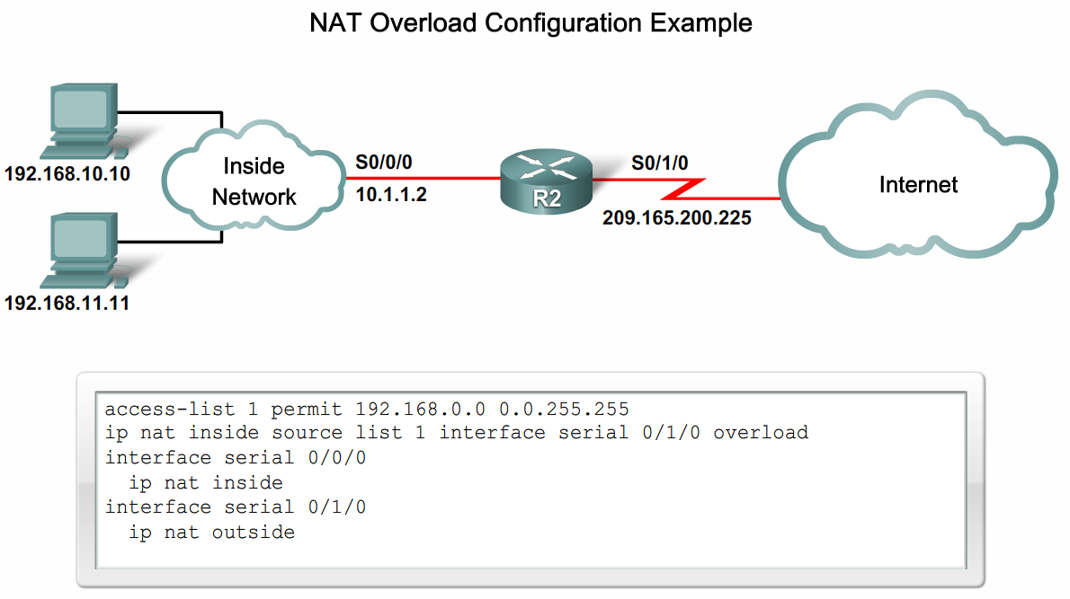
NAT overload

Slide 16
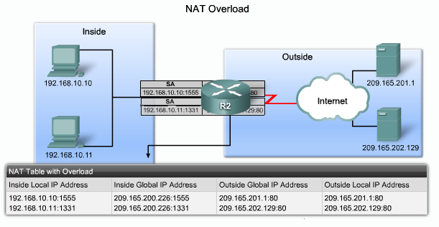
NAT overload

Slide 17
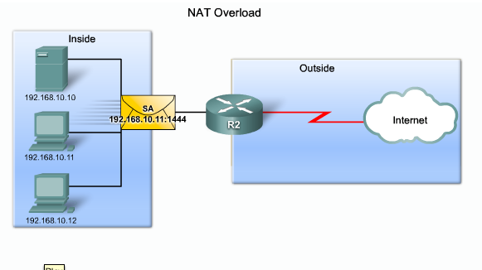
NAT overload

Slide 18
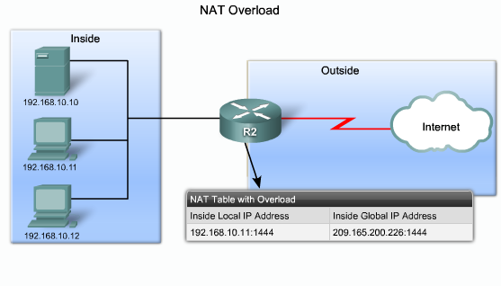
NAT overload

Slide 19
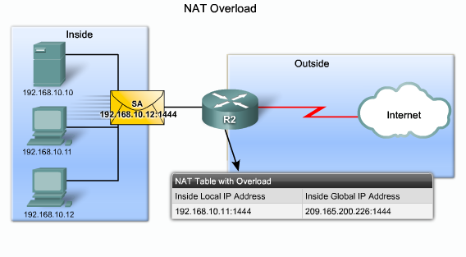
NAT overload

Slide 20
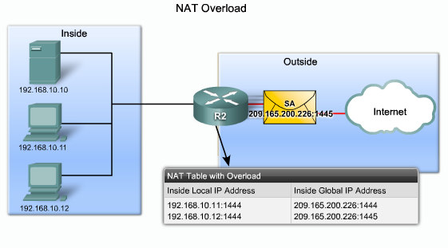
NAT overload

Slide 21
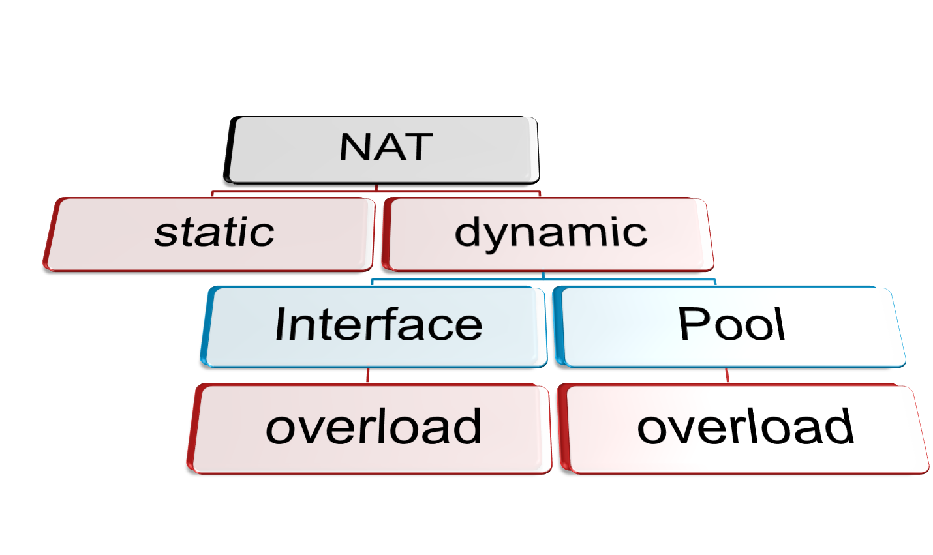
NAT with overload configuration

Slide 22
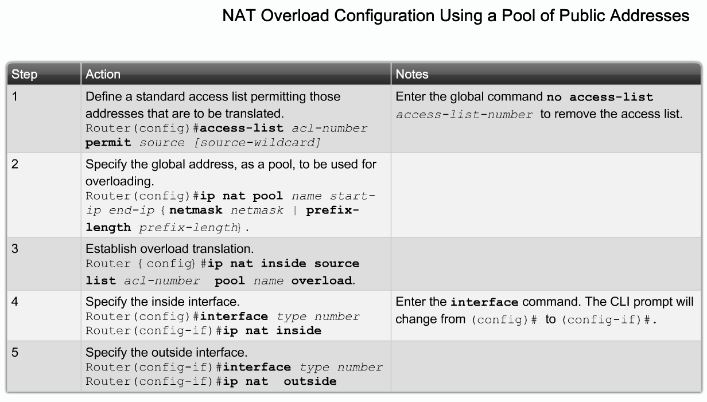
NAT/PAT with address pool

Slide 23
Dynamic NAT pool
NAT pool
  Router(config)# ip nat pool NAME start-public-ip end-public-ip netmask subnet-mask
Access-list
  Router(config)# access-list (NO) …………………….
1+2
  Router(config)# ip nat inside source list (NO) pool NAME overload
Apply NAT under interface
  At input interface → Router(config-if)#ip nat inside
  At output interface → Router(config-if)#ip nat outside

Slide 24
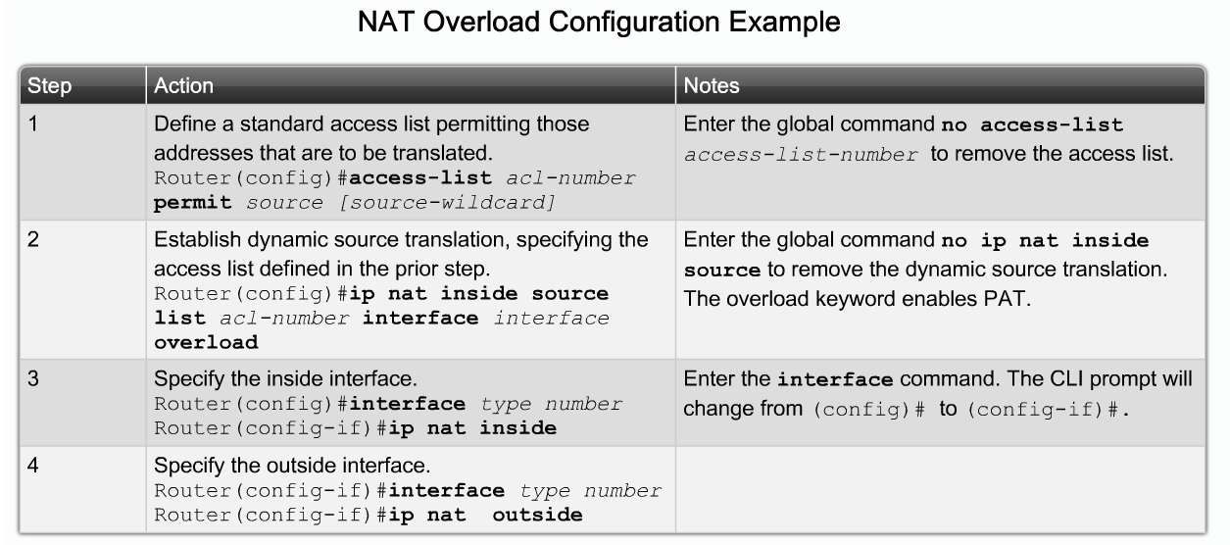
NAT/PAT with interface address

Slide 25
Dynamic NAT with interface address
Specify the interface address used
Access-list
  Router(config)# access-list (NO) …………………….
1+2
  Router(config)# ip nat inside source list (NO) interface interface-type overload
Apply NAT under interface
  At input interface → Router(config-if)#ip nat inside
  At output interface → Router(config-if)#ip nat outside

Slide 26
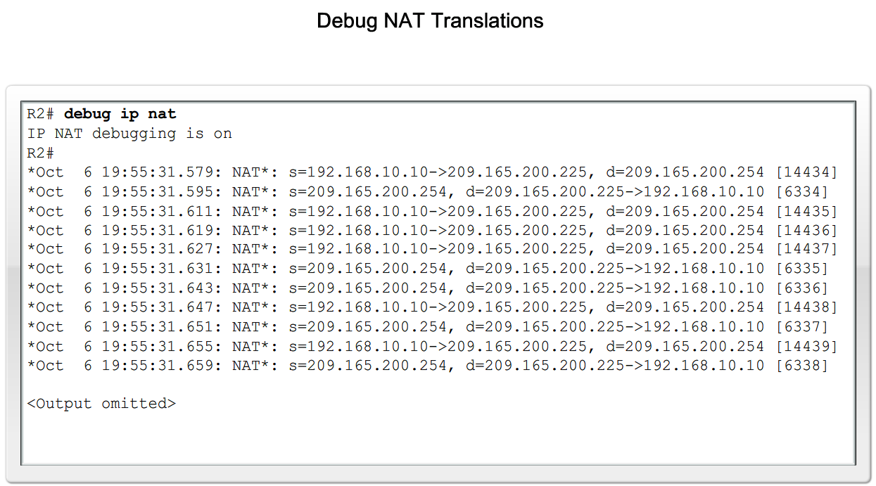
Monitor NAT behavior

